Slide 1
Implementing a Prompt Flow layer for AI prompts in Azure Foundry
Prompt Correction
Team 1
Marcelo Diaz
Enrique Aguilar

Slide 2

Introduction
Instructional Design Challenge: In a world where generative artificial intelligence is on the rise, the ability to design precise and contextualized instructions becomes crucial to maximize their potential, avoid unwanted biases, and ensure ethical, consistent, and human-aligned outcomes.

Slide 3

GenAI
Microsoft Azure leads GenAI not only for its technology, but also for its ability to solve real organizational problems: scalability, security, integration, and ethics. By combining its world-class infrastructure, strategic partnerships (OpenAI, NVIDIA), and a user-centric ecosystem, Azure is positioned as the platform of choice for companies seeking to innovate without compromising governance.

Slide 4
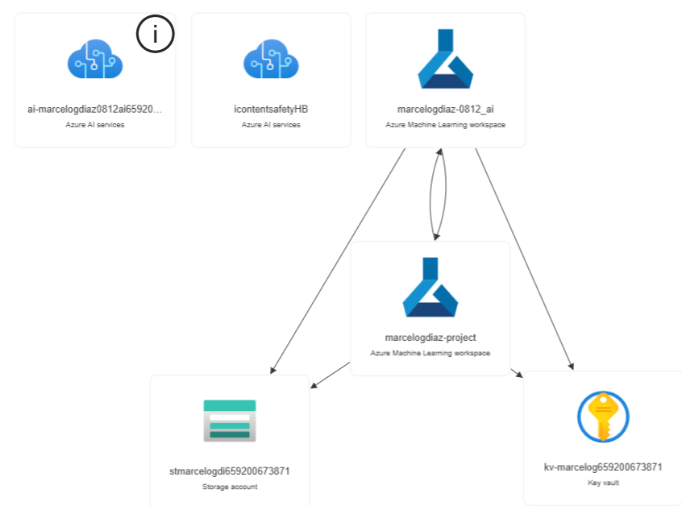
AI Services
For the implementation of the Flow, the following Azure services were instantiated:
Azure AI Service: to host the Resource Group.
Azure AI Service : to host the Azure AI Content Safety service.
Azure Machine Learning Workspace: to host the Azure AI Hub.
Azure Machine Learning Workspace: to host the Azure AI Foundry Project.
Storage Account: to host the Azure Blob Storage service for the Azure AI Foundry Project.
Key Vault: to securely store and manage secrets, keys, and certificates for the Azure AI Foundry Project.

Slide 5
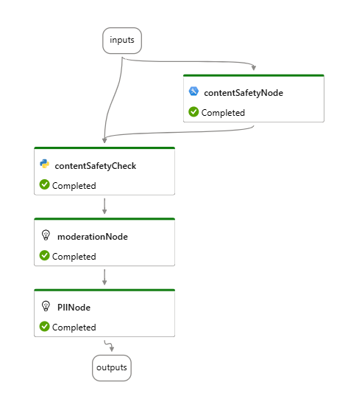
Architecture
This Flow responsible for ensuring that the input prompt does not contain harmful or sensitive content has the following Nodes:
Input: A text input with the user’s original prompt.
contentSafetyNode: This is an Azure AI Content Safety service module that detects harmful content such as hate, self-harm , sexual content, or violent language in the user's original prompt and flag objectionable content.
contentSafetyCheck: A Python script that analyze the contentSafetyNode output and generate a JSON with the status and category of this analysis.
moderationNode: An OpenAI-based using GPT-4o module that rewrites the original prompt to eliminate sensitive content based on the category informed, generating a safer alternative.
PIINode: An OpenAI-based using GPT-4o module focused on detecting and replacing personally identifiable information (PII) from the moderationNode output.
Output: enhanced Prompt.

Slide 6
Harmful language detection
The system will implement a mechanism that uses advanced algorithms to identify potentially harmful or sensitive language in user input. Using natural language processing techniques, the software will evaluate queries for terms or phrases that may be offensive, discriminatory, or otherwise inappropriate. Once detected, safer alternatives will be suggested, ensuring a more positive and respectful interaction environment.

Slide 7
Ethical content moderation
To ensure that interactions comply with ethical standards, the system will incorporate a moderation module that will review entries based on established guidelines. This will allow for filtering out content that is not only inappropriate but also risks violating legal or ethical guidelines. Moderation will be carried out automatically, ensuring that all interactions align with standards of responsible and ethical conduct.

Slide 8

Protection of personal information
The system will prioritize user privacy by implementing measures to identify and remove personally identifiable information (PII) from queries. Any data that could be used to identify an individual will be flagged and treated in accordance with data protection best practices. This not only protects user privacy but also ensures that the AI ​​does not process sensitive information that could give rise to legal or ethical issues.

Slide 9
Conclusions
Developing a robust preprocessing system that optimizes input before sending it to the AI ​​is crucial to improving both response quality and user safety. By implementing grammar checks, harmful language detection, and ethical moderation, we ensure more effective and responsible interactions, aligned with the standards of modern society.

Slide 10
Thank you!
Do you have any questions?

